Slide 1
Statistics 367-1-4361 Hierarchical Models
Opher Donchin

Slide 2
7A Review

Slide 3
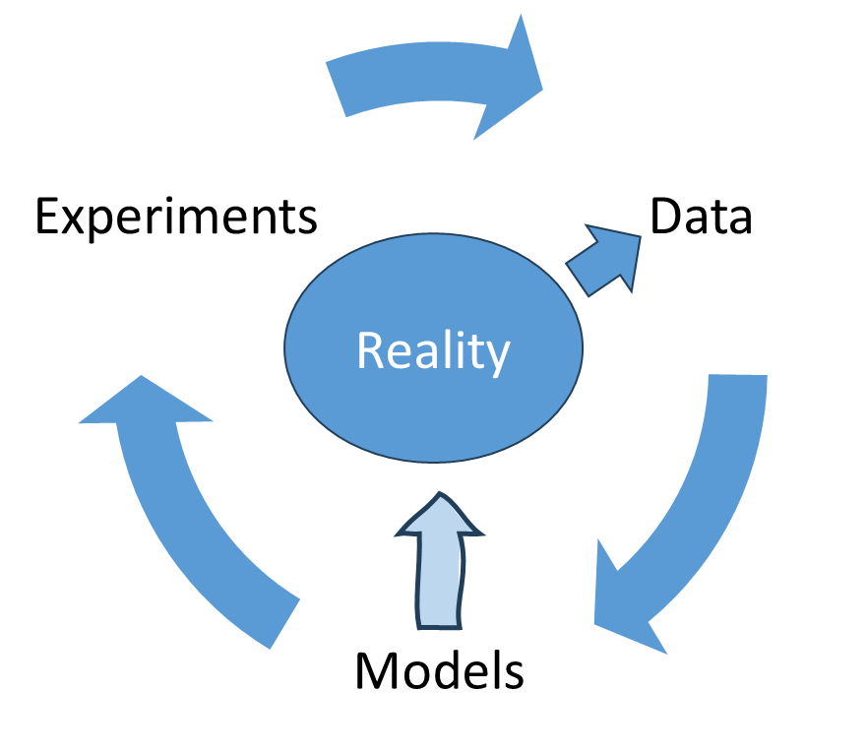
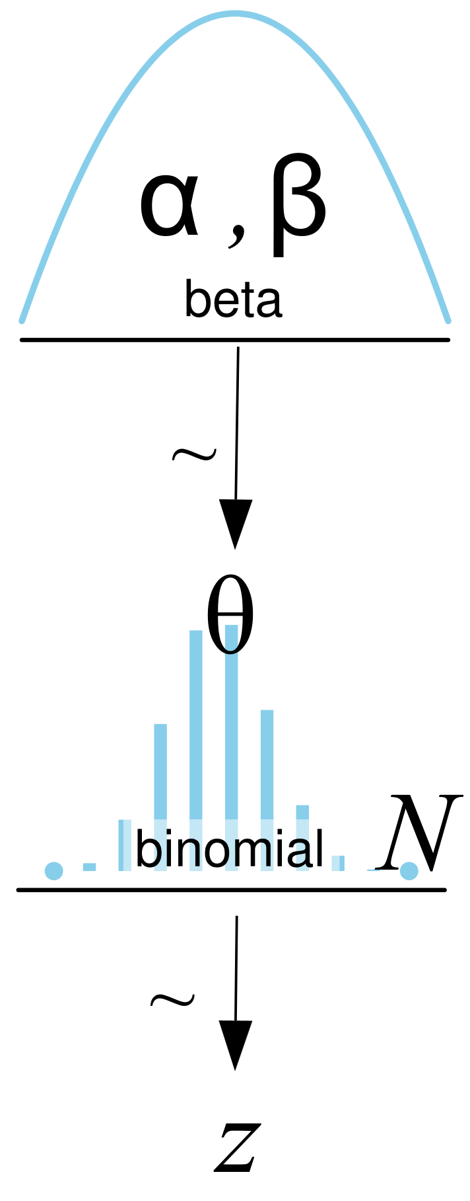
Models

Slide 4
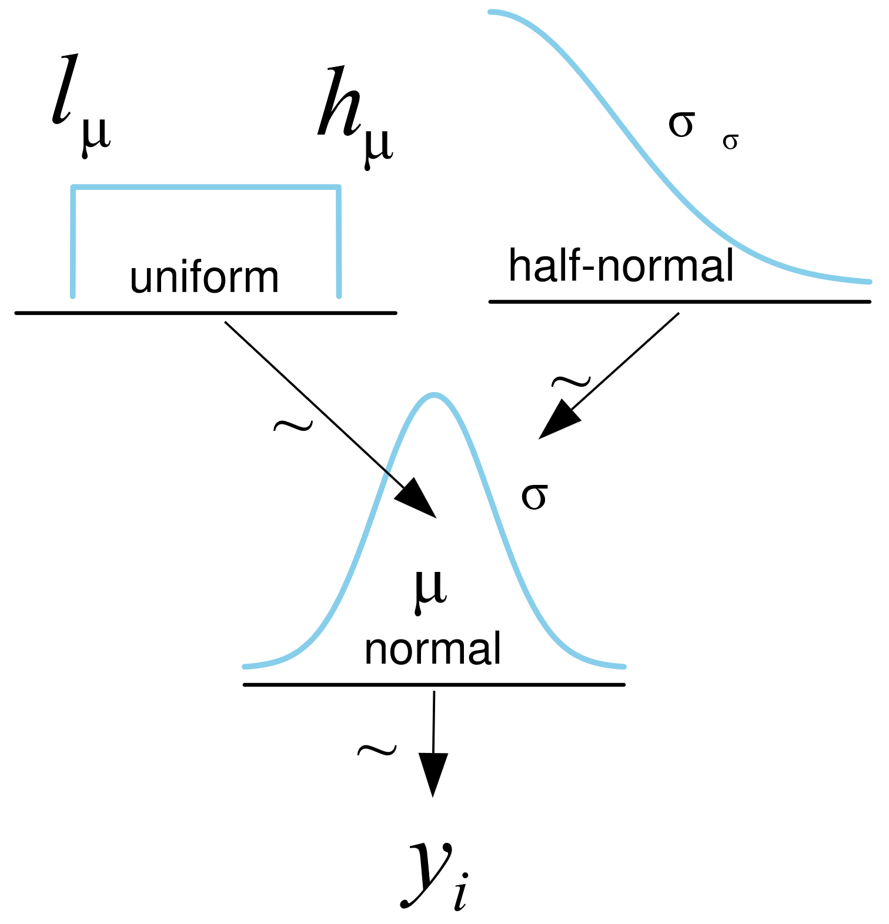
Priors
Each parameter has a prior distribution

Slide 5
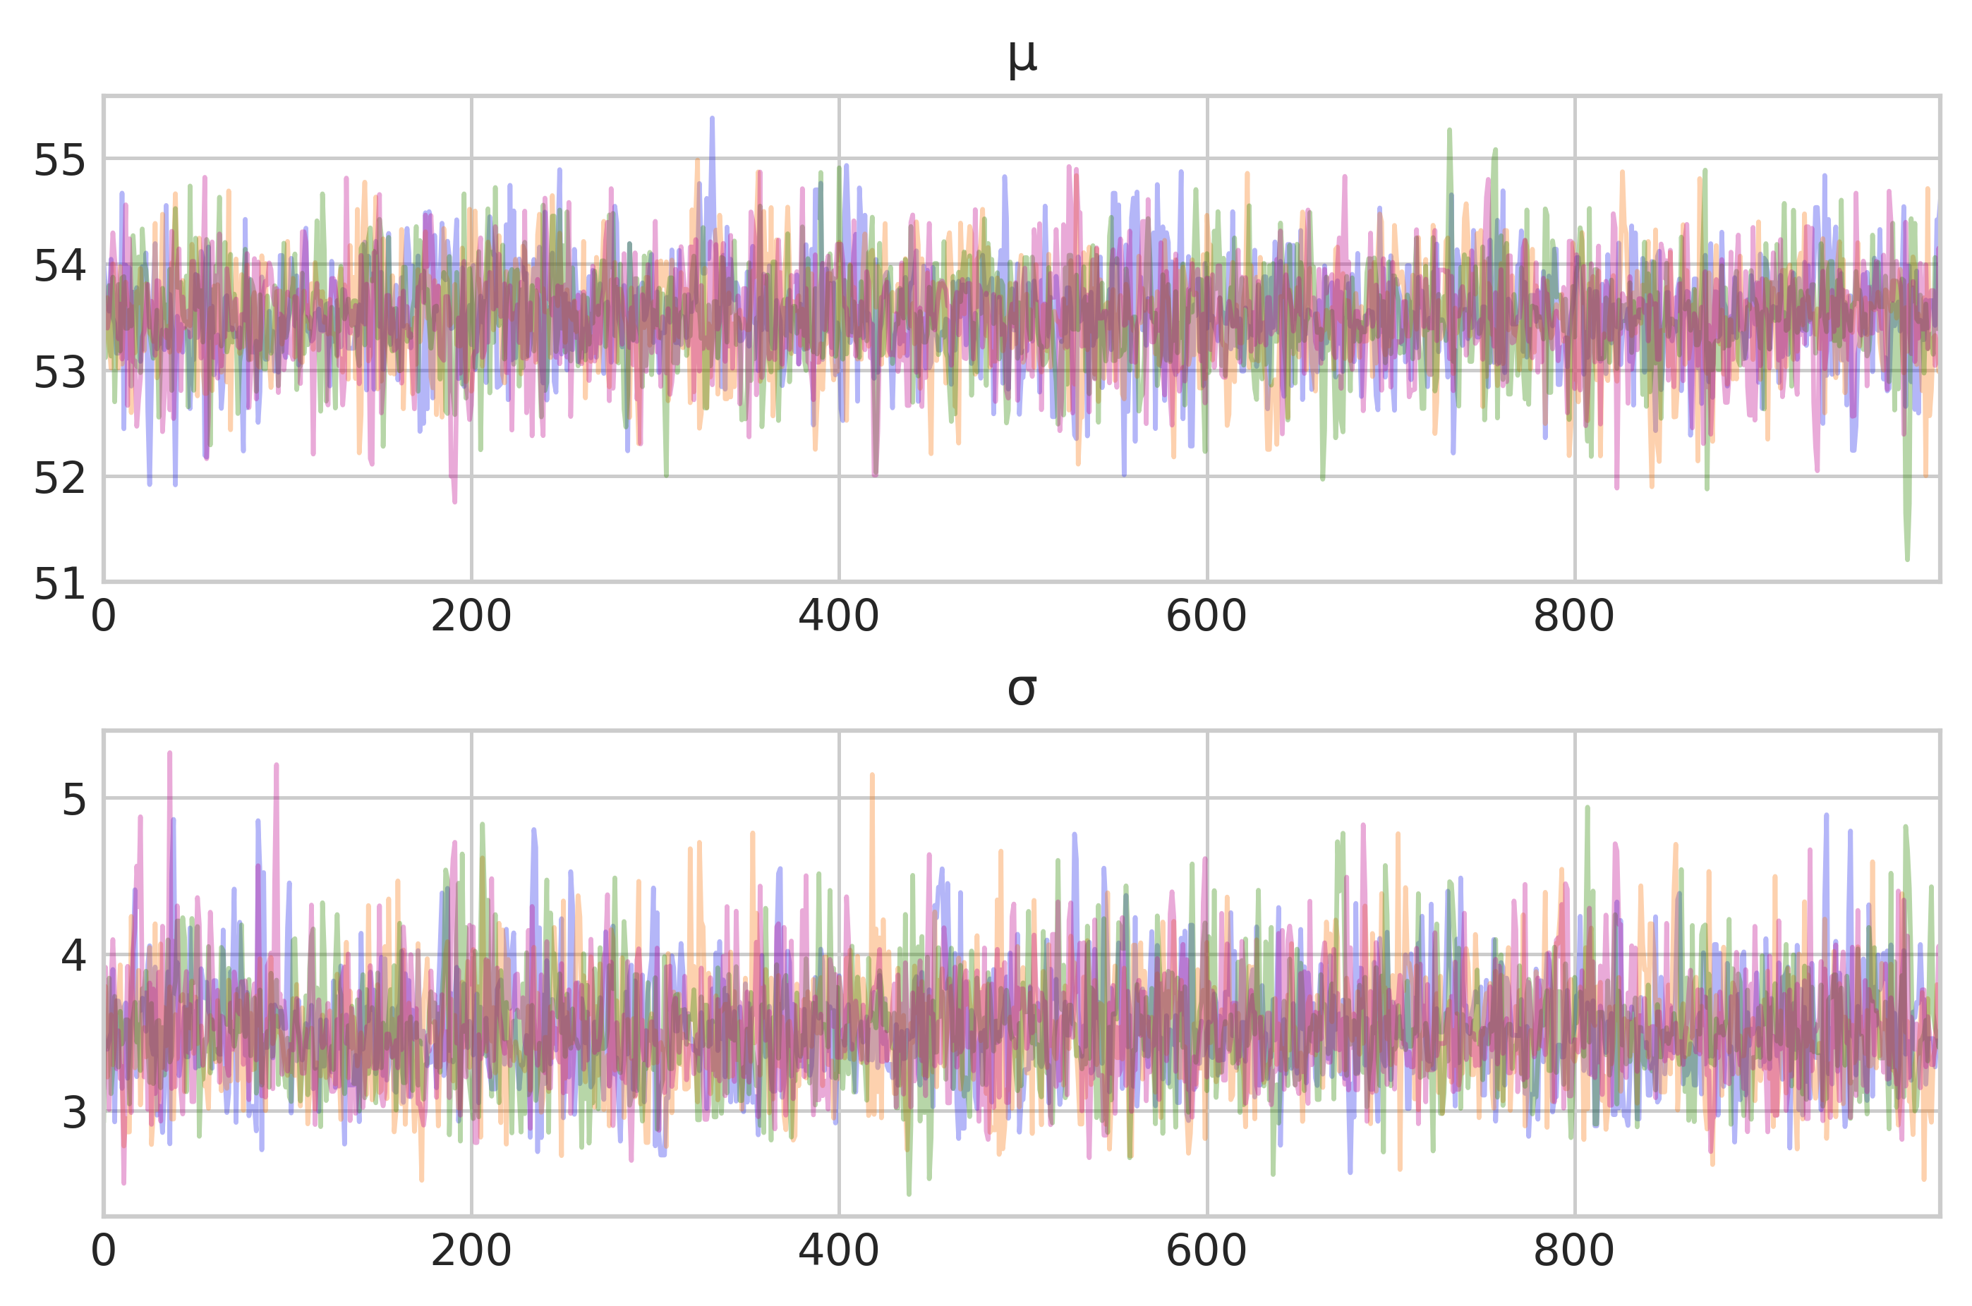
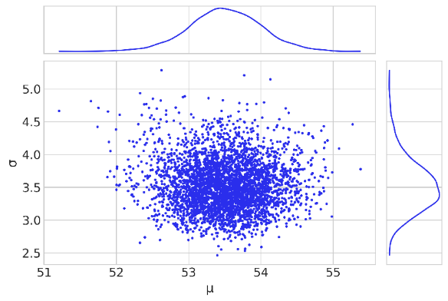
Sampling and joint posteriors

Slide 6
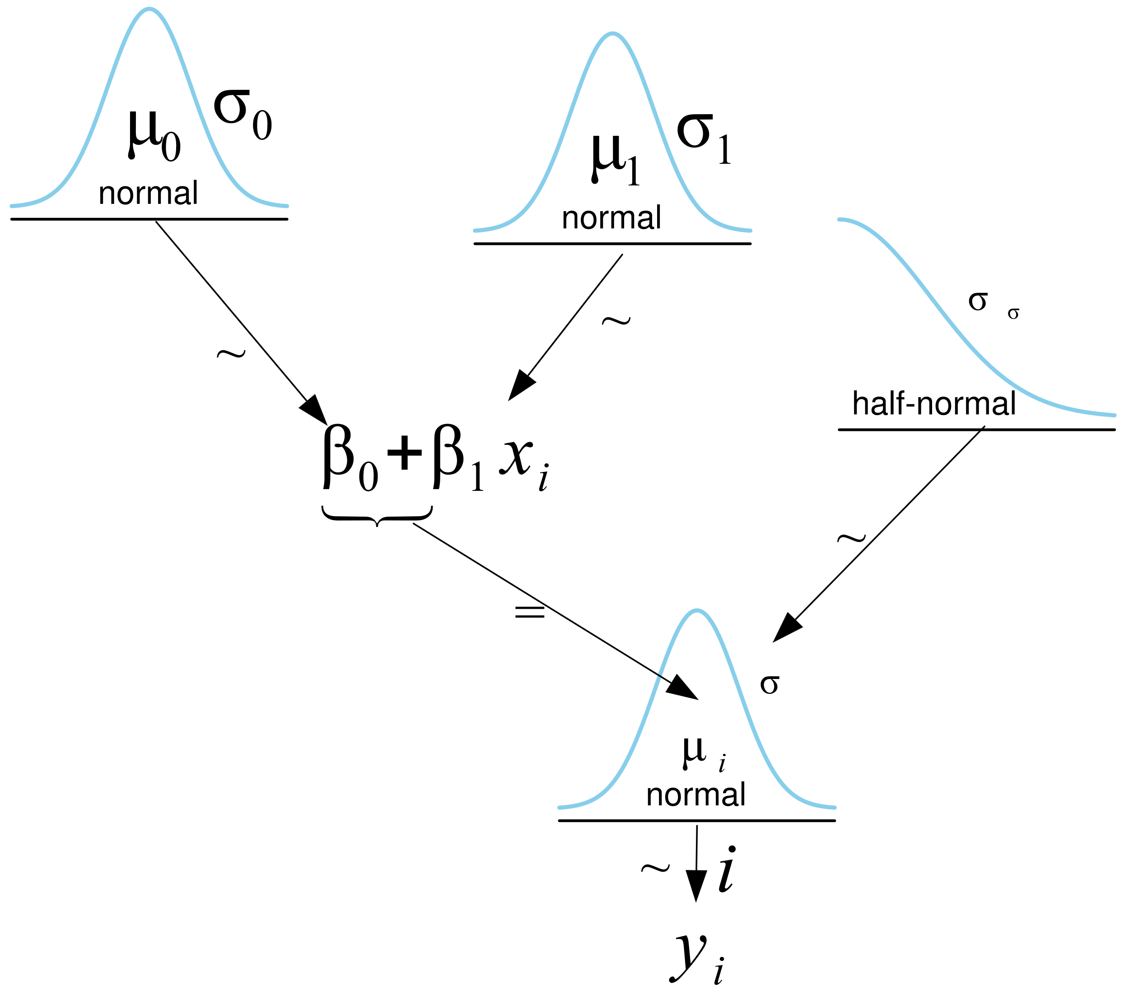
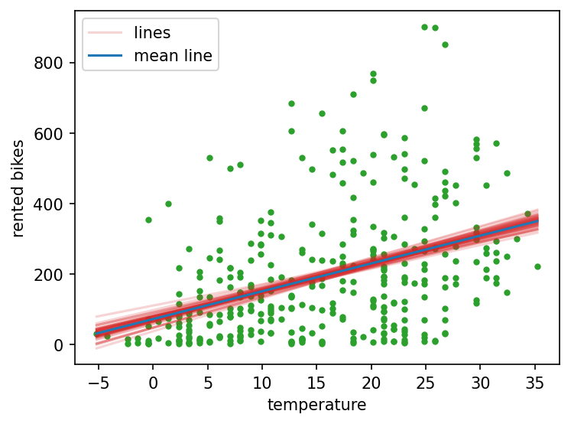
Linear models

Slide 7

It's Kahoot Time!
Notes:
Get ready for an interactive and fun learning experience with Kahoot! This engaging platform allows users to create, share, and play quizzes in real-time. Perfect for classrooms, meetings, and social gatherings, Kahoot helps reinforce knowledge while keeping participants entertained. Join the game by entering the unique PIN and test your knowledge against others!

Slide 8
7B Hierachical Models

Slide 9
Grouped data is common
Multiple drugs applied to different cell cultures
Each subject does multiple sessions of EEG
And each session has multiple trials
Animals are divided into treatment groups
And each animal is measured at multiple time points
Each subject tries multiple protheses
Each prostethic is evaluated over several days
On every day there are several trials

Slide 10
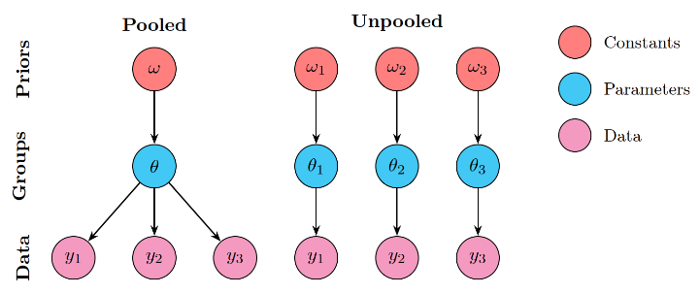
Two extreme options
Pretend groups don’t exist
Make ‘pooled’ parameter estimates
Only one set of group parameters
Pretend groups are unrelated
Make ‘unpooled’ parameter estimates
Each group has independent parameters

Slide 11
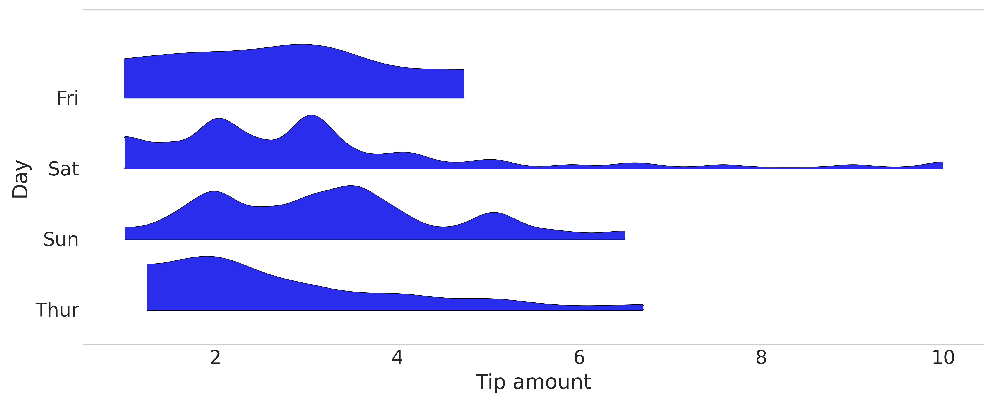
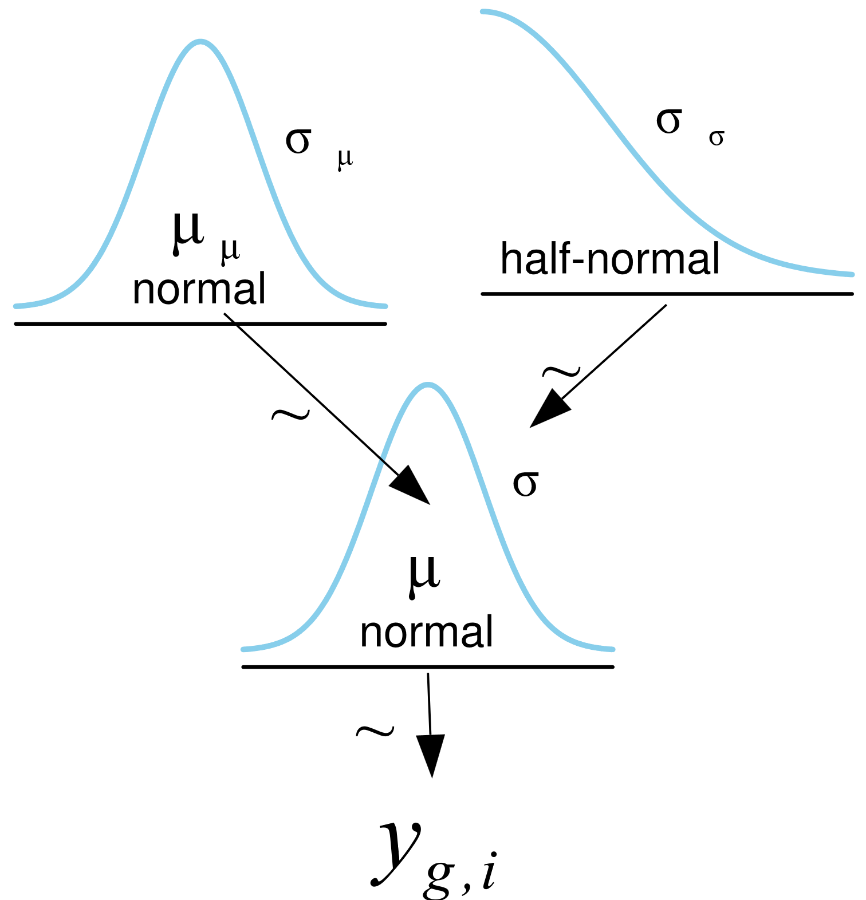
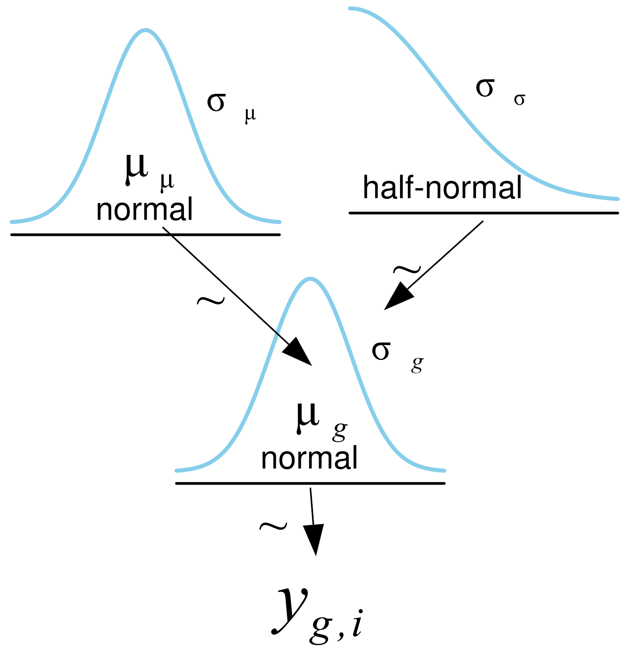
Tips data
4 groups
Pooled and unpooled models are possible
The unpooled model seems to have 1 prior
But it is really 4 identical priors
Pooled
Unpooled

Slide 12
Pooled and unpooled PyMC
PyMC would accept a vector for sigma in the HalfNormal
They really are different priors
Pooled
Unpooled
with pm.Model(coords=pooled_coords) as pooled_model:
μ = pm.HalfNormal("μ", sigma=σ_μ)
σ = pm.HalfNormal("σ", sigma=σ_σ)
y = pm.Gamma("y", mu=μ, sigma=σ, observed=tip, dims="data")
with pm.Model(coords=unpooled_coords) as unpooled_model:
μ = pm.HalfNormal("μ", sigma=σ_μ, dims="days")
σ = pm.HalfNormal("σ", sigma=σ_σ, dims="days")
y = pm.Gamma("y", mu=μ[idx], sigma=σ[idx], observed=tip, dims="days_flat")

Slide 13
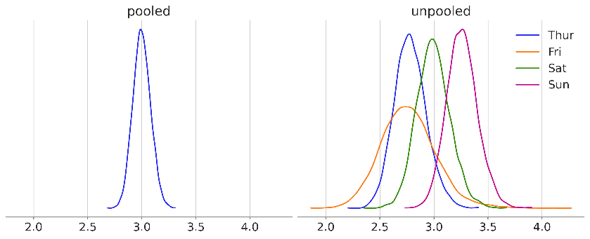
Pooled and unpooled posteriors
Pooled model
Less uncertainty
Shared information
Unpooled model
Parameters for each group
Information is not pooled

Slide 14
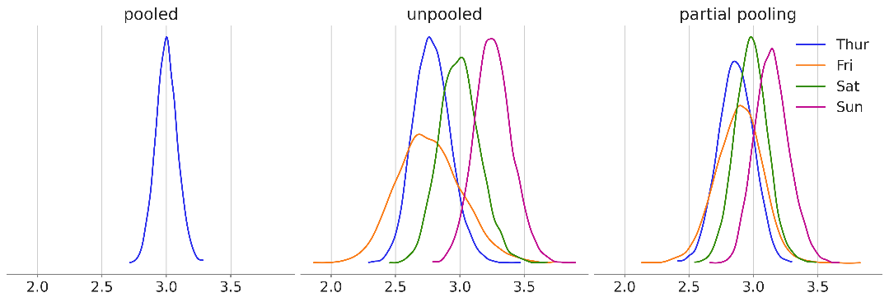
Partial pooling
Information sharing across groups
Separate parameters for each group

Slide 15
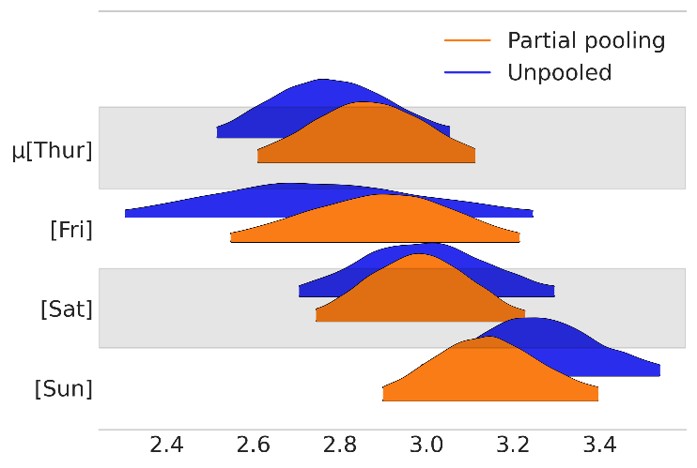
Compare the results
az.plot_forest([idatas["unpooled"], idatas["partial pooling"]],
var_names="μ", model_names=["Unpooled", "Partial pooling"],
kind="ridgeplot",
combined=True, figsize=(6, 4))
Partial pooling:
More narrow HDIs
Closer together

Slide 16
Rewriting our models
Constant
Parameter
Data
Colors for type of variable
Add the implicit parameters of the prior

Slide 17
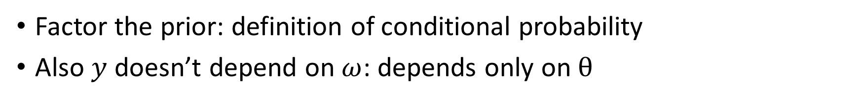
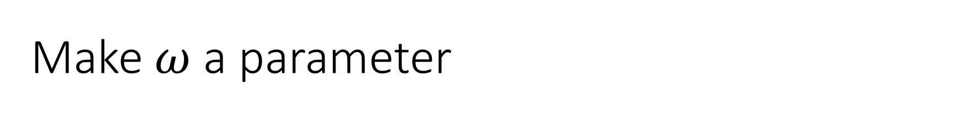
Make $ω$ a parameter
Constant
Parameter
Data
Factor the prior: definition of conditional probability
Also $y$ doesn’t depend on $ω$: depends only on $θ$

Slide 18
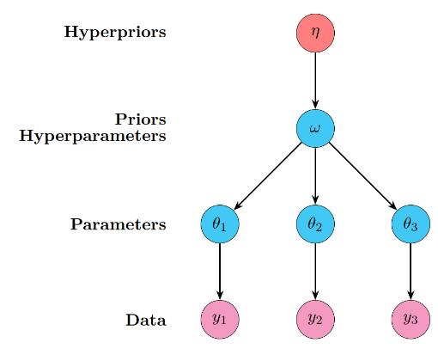
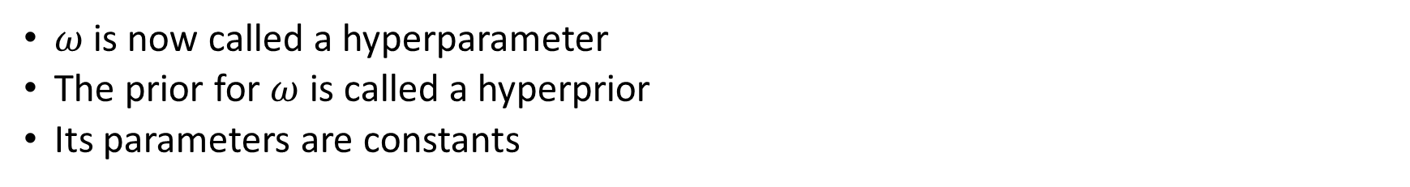
Hyperparameters and hyperpriors
$ω$ is now called a hyperparameter
The prior for $ω$ is called a hyperprior
Its parameters are constants

Slide 19
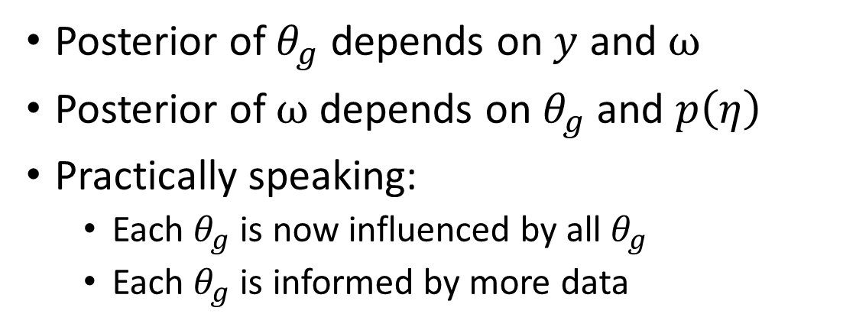
The hierarchical model
Posterior of $θ_{g}$ depends on $y$ and $ω$
Posterior of $ω$depends on $θ_{g}$ and $p\left(η\right)$
Practically speaking:
Each $θ_{g}$ is now influenced by all $θ_{g}$
Each $θ_{g}$ is informed by more data

Slide 20
7C Hierarchical models in PyMC

Slide 21
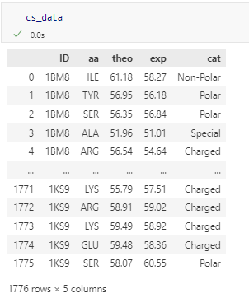
Chemical shift data: theory and experiment
Data columns:
Protein ID code
Amino acid within the protein
Theoretical value for chemical shift
Experimental value for chemical shift
Protein category
We will look at the difference between theory and experiment

Slide 22
Chemical shift data: theory and experiment
Pooled model
Ignore the amino acid
Unpooled model
Ignore similarity between amino acids
Partially pooled model
Hierarchical sharing of data

Slide 23
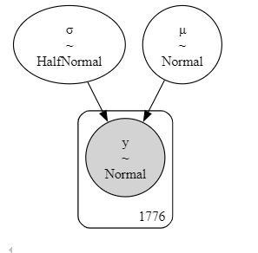
The pooled model
with pm.Model(coords=coords) as cs_p:
μ = pm.Normal('μ', mu=μ_μ, sigma=σ_μ)
σ = pm.HalfNormal('σ', sigma=σ_σ)
y = pm.Normal('y', mu=μ, sigma=σ, observed=diff)

Slide 24
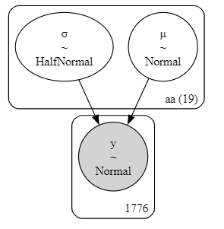
The unpooled model
with pm.Model(coords=coords) as cs_nh:
μ = pm.Normal('μ', mu=μ_μ, sigma=σ_μ, dims="aa")
σ = pm.HalfNormal('σ', sigma=σ_σ, dims="aa")
y = pm.Normal('y', mu=μ[idx], sigma=σ[idx], observed=diff)

Slide 25
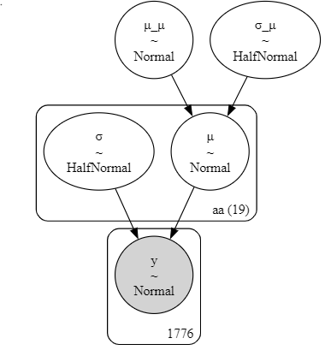
The hierarchical model
with pm.Model(coords=coords) as cs_h:
# hyper_priors
μ_μ = pm.Normal('μ_μ', mu=μ_μμ, sigma=σ_μμ)
σ_μ = pm.HalfNormal('σ_μ', σ_σμ)
# priors
μ = pm.Normal('μ', mu=μ_μ, sigma=σ_μ, dims="aa")
σ = pm.HalfNormal('σ', sigma=10, dims="aa")
y = pm.Normal('y', mu=μ[idx], sigma=σ[idx], observed=diff)

Slide 26
Comparing the models

Slide 27
Comparing the code
Pooled
Unpooled
with pm.Model(coords=coords) as cs_p:
μ = pm.Normal('μ', mu=μ_μ, sigma=σ_μ)
σ = pm.HalfNormal('σ', sigma=σ_σ)
y = pm.Normal('y', mu=μ, sigma=σ, observed=diff)
with pm.Model(coords=coords) as cs_nh:
μ = pm.Normal('μ', mu=μ_μ, sigma=σ_μ, dims="aa")
σ = pm.HalfNormal('σ', sigma=σ_σ, dims="aa")
y = pm.Normal('y', mu=μ[idx], sigma=σ[idx], observed=diff)
Hierarchical
with pm.Model(coords=coords) as cs_h:
# hyper_priors
μ_μ = pm.Normal('μ_μ', mu=μ_μμ, sigma=σ_μμ)
σ_μ = pm.HalfNormal('σ_μ', σ_σμ)
# priors
μ = pm.Normal('μ', mu=μ_μ, sigma=σ_μ, dims="aa")
σ = pm.HalfNormal('σ', sigma=10, dims="aa")
y = pm.Normal('y', mu=μ[idx], sigma=σ[idx], observed=diff)

Slide 28
7D What does the hierarchy do?

Slide 29
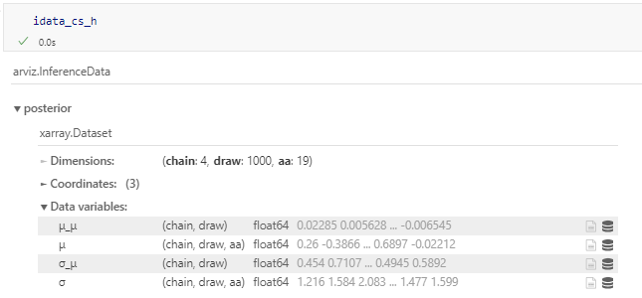
Hyperparameters are just parameters
Each MCMC sample contains a full set:
μ_μ, σ_μ
μ[aa], σ[aa]

Slide 30
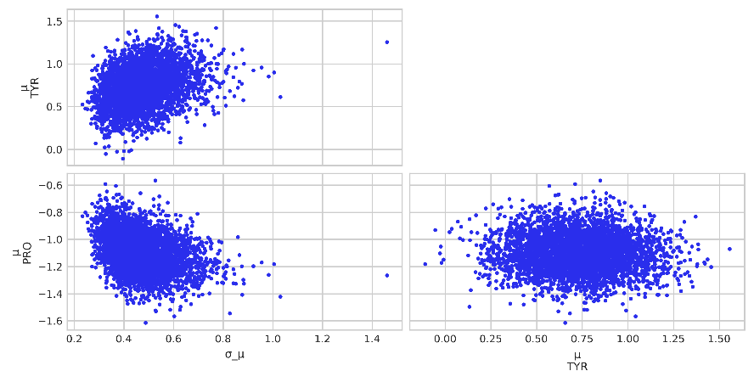
The parameters and hyperparameters are related
σ_μ is smaller when the μ are closer together
And vice versa

Slide 31
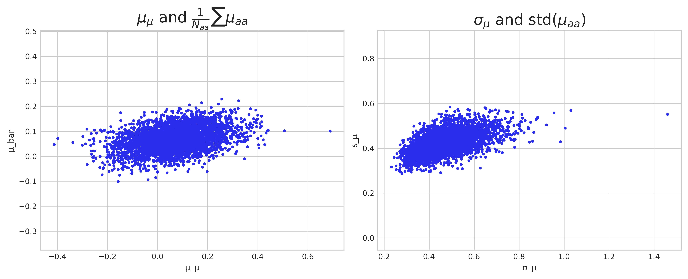
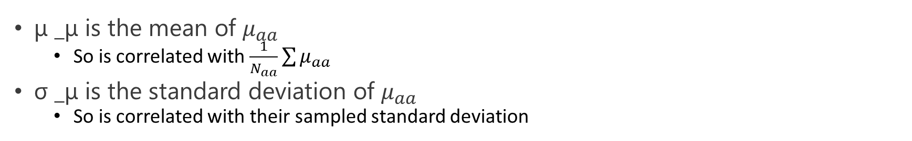
Summary statistics of the parameters
μ _μ is the mean of $μ_{aa}$
So is correlated with $\frac{1}{N_{aa}}\sum{μ_{aa}}$
σ _μ is the standard deviation of $μ_{aa}$
So is correlated with their sampled standard deviation

Slide 32
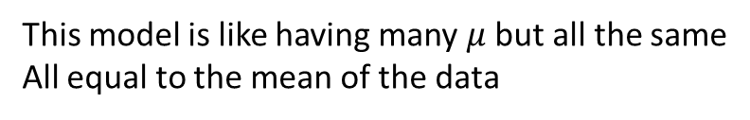
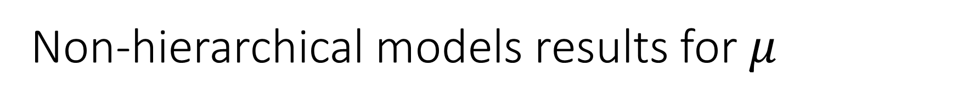
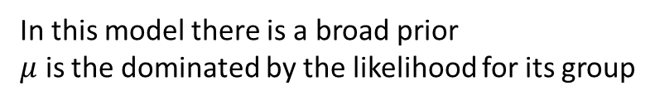
Non-hierarchical models results for $μ$
Pooled
Unpooled
with pm.Model(coords=coords) as cs_p:
μ = pm.Normal('μ', mu=μ_μ, sigma=σ_μ)
σ = pm.HalfNormal('σ', sigma=σ_σ)
y = pm.Normal('y', mu=μ, sigma=σ, observed=diff)
with pm.Model(coords=coords) as cs_nh:
μ = pm.Normal('μ', mu=μ_μ, sigma=σ_μ, dims="aa")
σ = pm.HalfNormal('σ', sigma=σ_σ, dims="aa")
y = pm.Normal('y', mu=μ[idx], sigma=σ[idx], observed=diff)
This model is like having many $μ$ but all the same
All equal to the mean of the data
In this model there is a broad prior
$μ$ is the dominated by the likelihood for its group

Slide 33
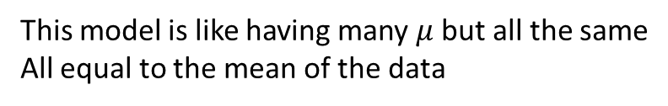
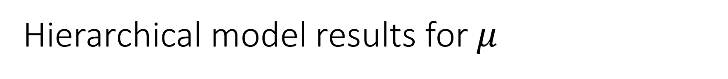
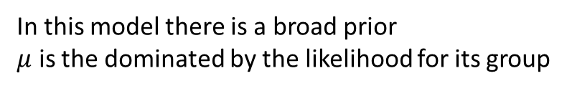
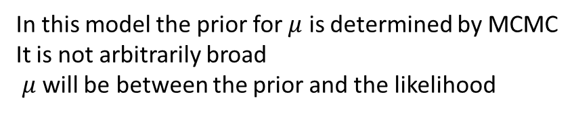
Hierarchical model results for $μ$
Pooled
Unpooled
This model is like having many $μ$ but all the same
All equal to the mean of the data
In this model there is a broad prior
$μ$ is the dominated by the likelihood for its group
Hierarchical
with pm.Model(coords=coords) as cs_h:
# hyper_priors
μ_μ = pm.Normal('μ_μ', mu=μ_μμ, sigma=σ_μμ)
σ_μ = pm.HalfNormal('σ_μ', σ_σμ)
# priors
μ = pm.Normal('μ', mu=μ_μ, sigma=σ_μ, dims="aa")
σ = pm.HalfNormal('σ', sigma=10, dims="aa")
y = pm.Normal('y', mu=μ[idx], sigma=σ[idx], observed=diff)
In this model the prior for $μ$ is determined by MCMC
It is not arbitrarily broad
$μ$ will be between the prior and the likelihood

Slide 34
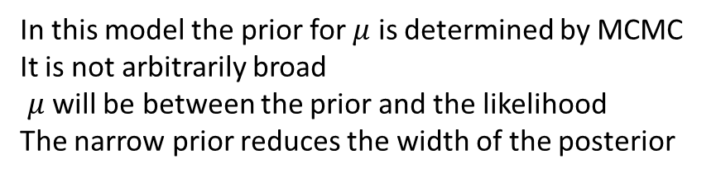
Hierarchical models create data-driven narrow priors
Pooled
Unpooled
This model is like having many $μ$ but all the same
All equal to the mean of the data
In this model there is a broad prior
$μ$ is the dominated by the likelihood for its group
Hierarchical
In this model the prior for $μ$ is determined by MCMC
It is not arbitrarily broad
$μ$ will be between the prior and the likelihood
The narrow prior reduces the width of the posterior
Pooled model σ_μ: 0
Hierarchical model σ_μ: 0.47 ± 0.10
Unpooled model σ_μ: 10
Pooled model std(μ): 0
Hierarchical model std(μ): 0.42 ± 0.05
Unpooled model std(μ): 0.51 ± 0.05

Slide 35
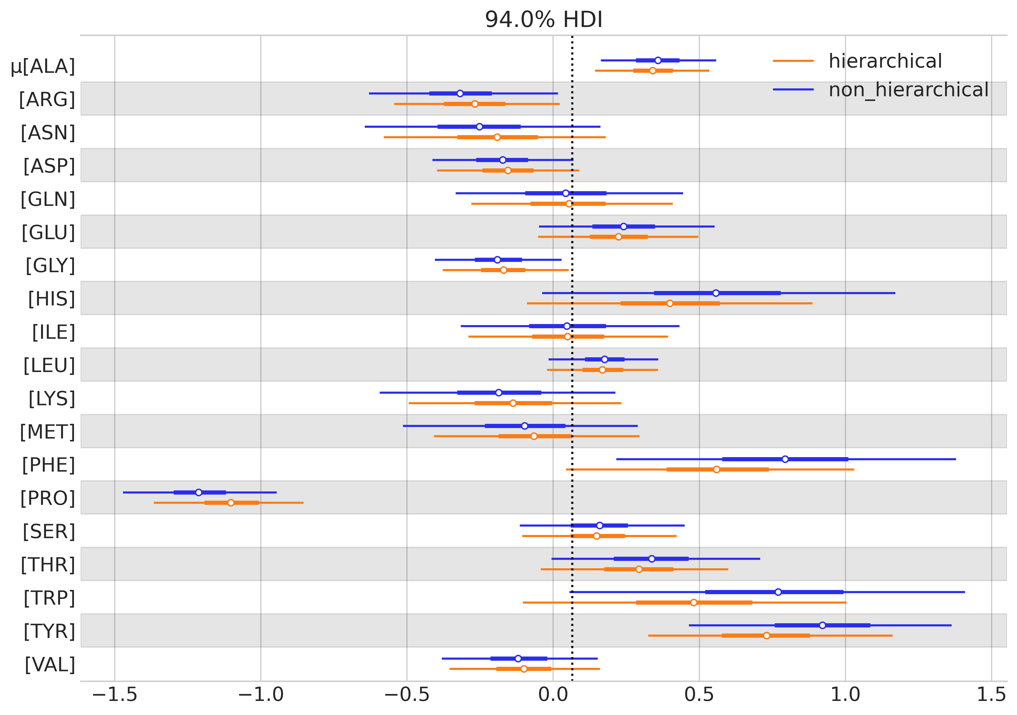
Shrinkage and reduced uncertainty

Slide 36
7E Benefits and pitfalls

Slide 37
Benefits and pitfalls of hierarchical models
Benefits
Pitfalls
Model structured data
Balance
Population information
Group information
Robust estimation
Even if some groups have less data
Computational complexity
Increased fitting time
Importance of sampling diagnostics
Priors disconnected from data
Importance of prior predictive
Interpretational complexity
Simultaneous interpretation at multiple levels

Slide 39
It's Kahoot Time!
Notes:
Get ready for an interactive and fun learning experience with Kahoot! This engaging platform allows users to create, share, and play quizzes in real-time. Perfect for classrooms, meetings, and social gatherings, Kahoot helps reinforce knowledge while keeping participants entertained. Join the game by entering the unique PIN and test your knowledge against others!

Slide 40
7F Multiple levels of hierarchy

Slide 41
Hierarchy can come at multiple levels
MRI scans
Taken on 100 different individual machines
That are all from 5 different models
And the models are all from a single population
Firing rates of neurons
From different brain areas
In different individuals
And the overall population of neurons
Tests of biomaterial strengths
Generated in multiple batches
Using different formulations
And the overall properties of the material

Slide 42
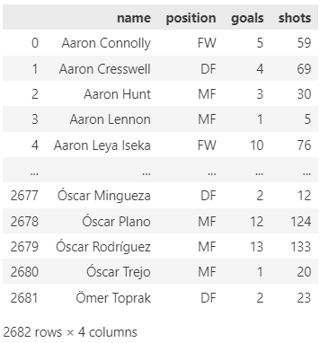
Our BME relevant example
Football players
Actual number of shots taken and goals scored
Player probability of success
Players play different positions
And these are all part of the larger population

Slide 43
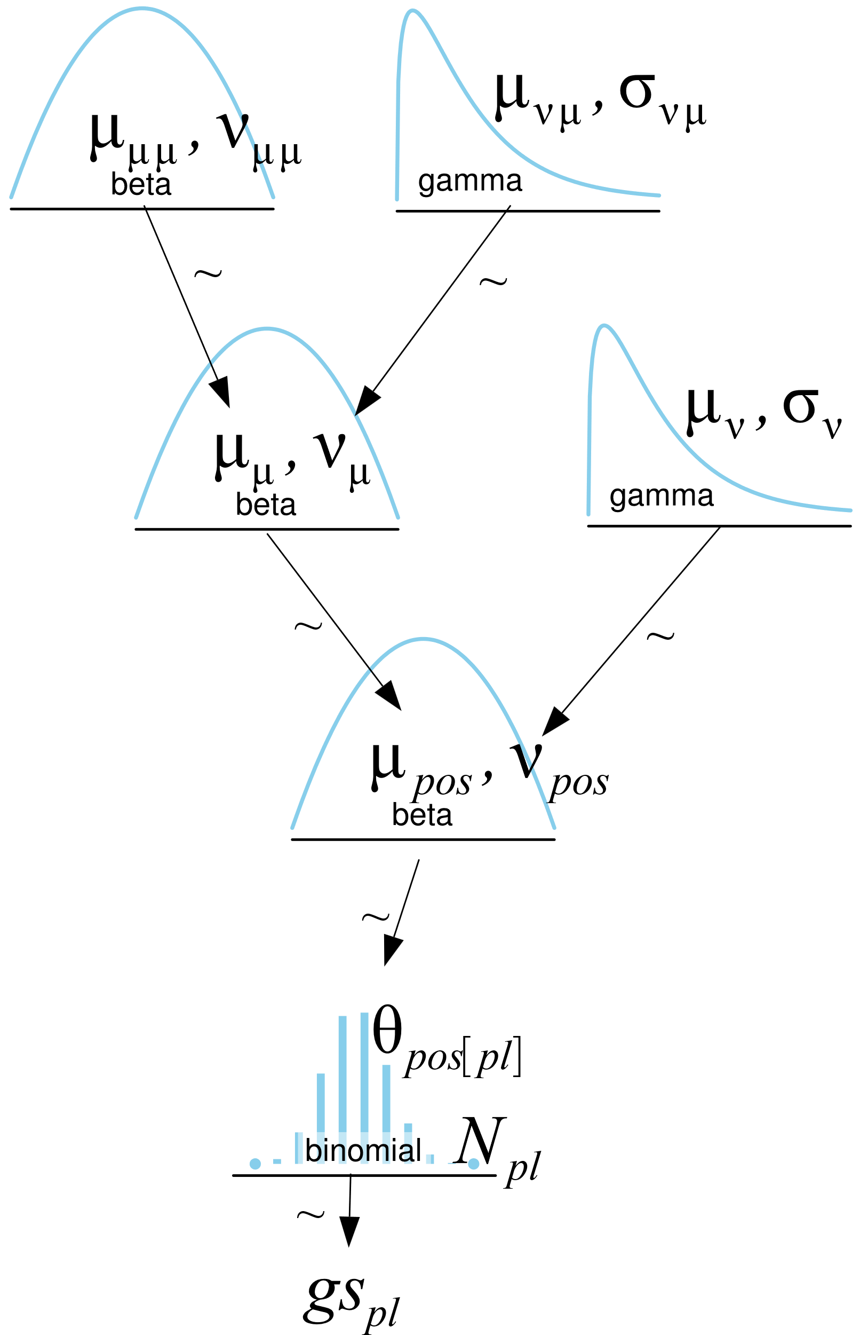
Model step 1: likelihood
Each player:
Number of shots taken
Actual goals scored
Probability of success

Slide 44
Model step 2: parameter
Each player:
Actual goals scored
Probability of success
Beta distributed
Distribution depends on position
Paramaterized by
Mean
Mean of players at the position
Concentration
Similarity of players at the position

Slide 45
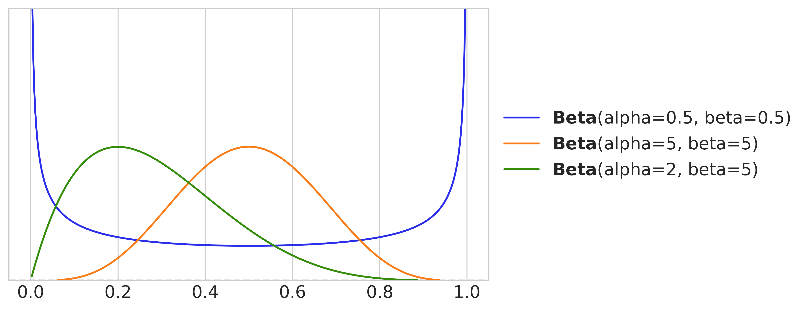
Parameterizations of the Beta distribution
As a prior equivalent to a number of successes and failures

Slide 46
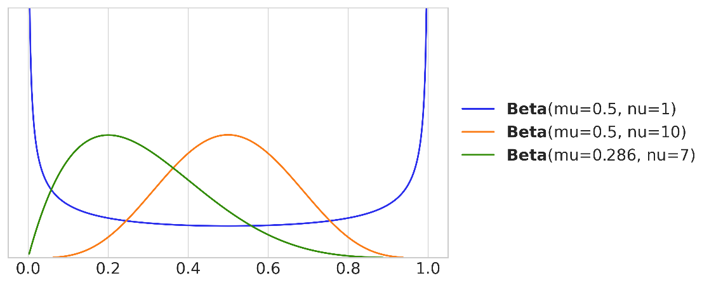
Parameterizations of the Beta distribution
As a prior equivalent to number of attempts and mean success rate

Slide 47
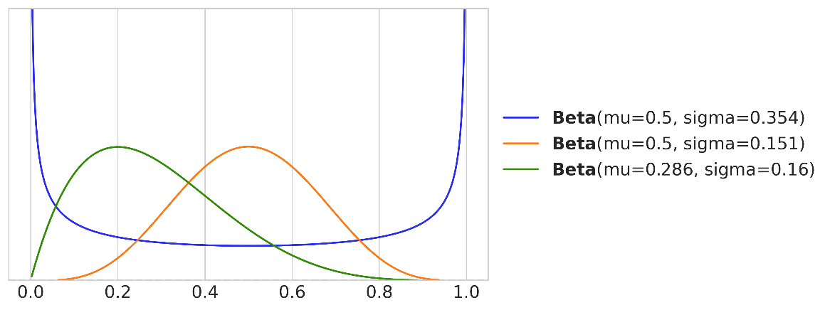
Parameterizations of the Beta distribution
By the mean and the width

Slide 48
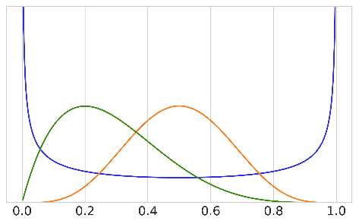
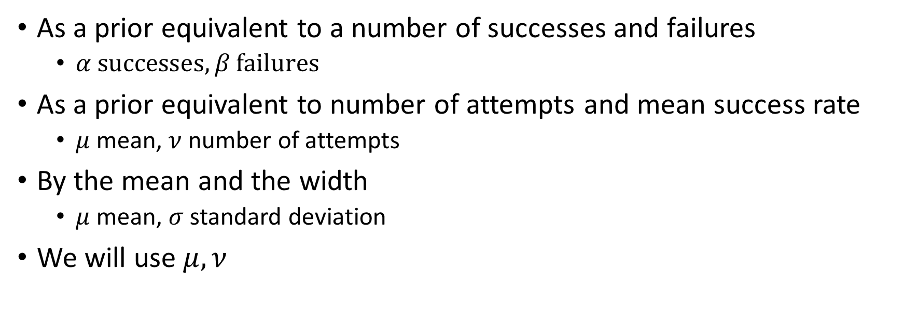
Parameterizations of the Beta distribution
As a prior equivalent to a number of successes and failures
$α \text{successes}, β \text{failures}$
As a prior equivalent to number of attempts and mean success rate
$μ$ mean, $ν$ number of attempts
By the mean and the width
$μ$ mean, $σ$ standard deviation
We will use $μ, ν$

Slide 49

Model step 3: hyperparameter
Each player:
Actual goals scored
Probability of success: Beta distributed
Mean (for position)
Beta distributed
Distribution across positions
Mean
Mean over all positions
Concentration
Similarity of positions
Concentration (for position)

Slide 50
Model step 4a: hyperprior
Each player:
Actual goals scored
Probability of success: Beta distributed
Mean (for position)
Beta distributed
Distribution across positions
Mean
Mean over all positions
Beta prior
Concentration
Similarity of positions
Gamma prior
Concentration (for position)

Slide 51
Model step 4b: hyperprior 2
Each player:
Actual goals scored
Probability of success: Beta distributed
Mean (for position)
Beta distributed
Distribution across positions
Mean over all positions
Beta prior
Concentration: similarity of positions
Gamma prior
Concentration (for position)
Similarity of players within a position
Gamma prior

Slide 52
Model code
coords = {"pos": pos_codes, "players": np.arange(n_players)}
with pm.Model(coords=coords) as model_football:
# Hyper parameters
μ_μ = pm.Beta('μ_μ', mu=μ_μμ, nu=ν_μμ)
ν_μ = pm.Gamma('ν_μ', mu=μ_νμ, sigma=σ_νμ)
# Parameters for positions
μ_p = pm.Beta('μ_p',
mu=μ_μ,
nu=ν_μ,
dims = "pos")
ν_p = pm.Gamma('ν_p', mu=μ_ν, sigma=σ_ν, dims="pos")
# Parameter for players
θ = pm.Beta('θ',
mu=μ_p[pos_idx],
nu=ν_p[pos_idx])
_ = pm.Binomial('gs', n=football.shots.values, p=θ,
observed=football.goals.values, dims="players")

Slide 53
Setting priors
coords = {"pos": pos_codes, "players": np.arange(n_players)}
with pm.Model(coords=coords) as model_football:
# Hyper parameters
μ_μ = pm.Beta('μ_μ', mu=μ_μμ, nu=ν_μμ)
ν_μ = pm.Gamma('ν_μ', mu=μ_νμ, sigma=σ_νμ)
# Parameters for positions
μ_p = pm.Beta('μ_p',
mu=μ_μ,
nu=ν_μ,
dims = "pos")
ν_p = pm.Gamma('ν_p', mu=μ_ν, sigma=σ_ν, dims="pos")
# Parameter for players
θ = pm.Beta('θ',
mu=μ_p[pos_idx],
nu=ν_p[pos_idx])
_ = pm.Binomial('gs', n=football.shots.values, p=θ,
observed=football.goals.values, dims="players")
μ_μ
Average player between 0.0 and 0.5
ν_μ and ν_p
Actually set using standard deviation
Positions could affect the average by between 0.02 and 0.1
Used preliz to find appropriate Beta and Gamma priors

Slide 54
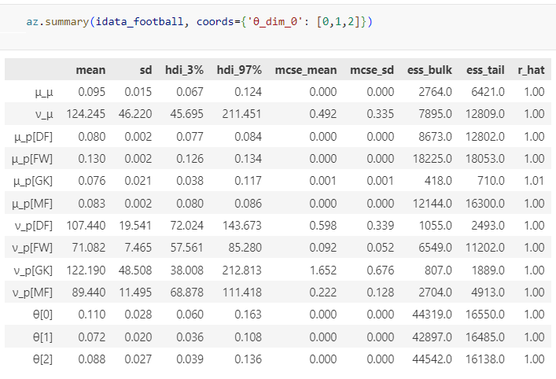
The parameters in the posterior
The mean cross positions
The mean of each position
The success rates of individuals

Slide 55
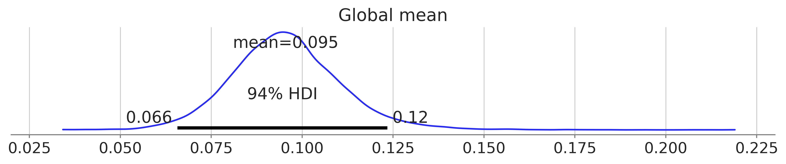
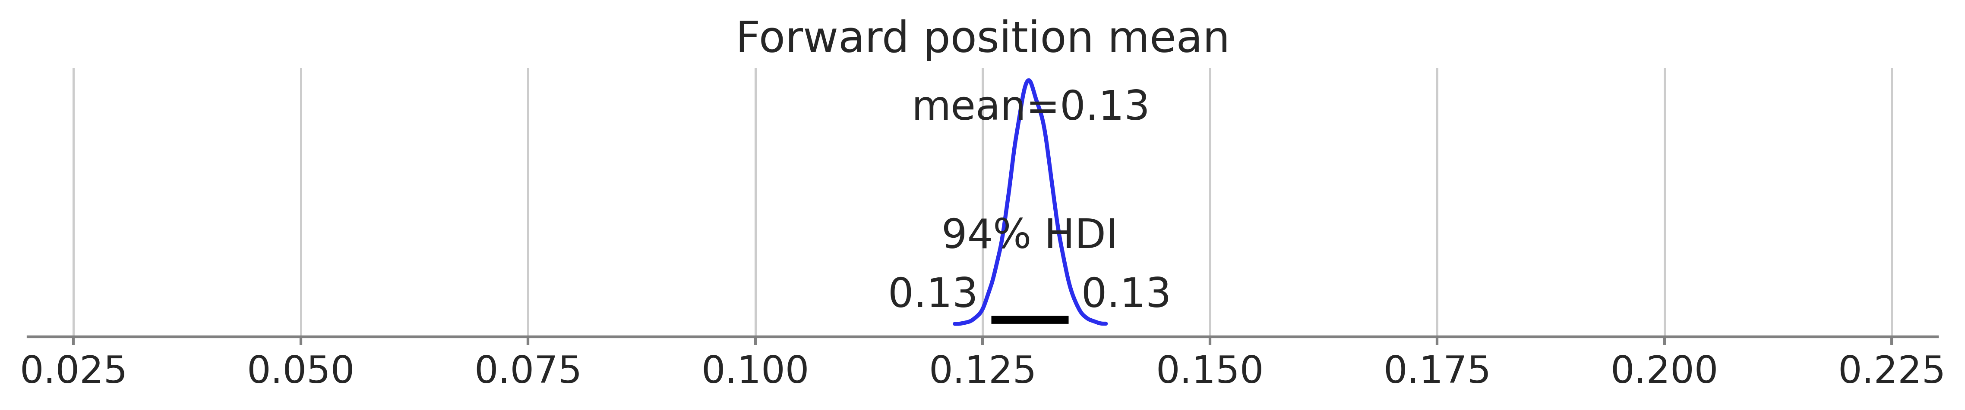
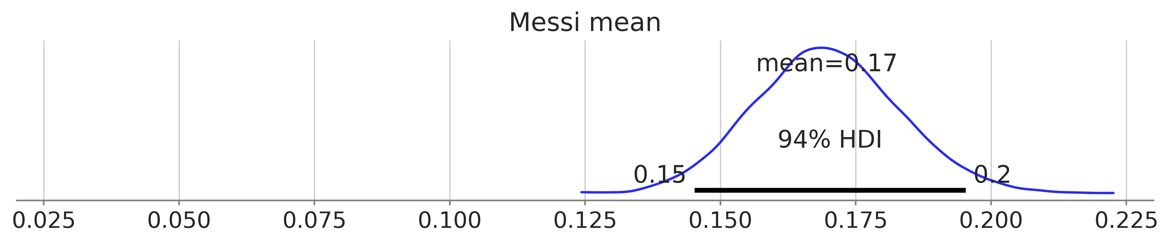
Comparing population, position and individual means
Players succeed around 10% of the time
Forwards are the best at shooting
Messi is the best forward

Slide 56
7F Hierarchical regression

Slide 57
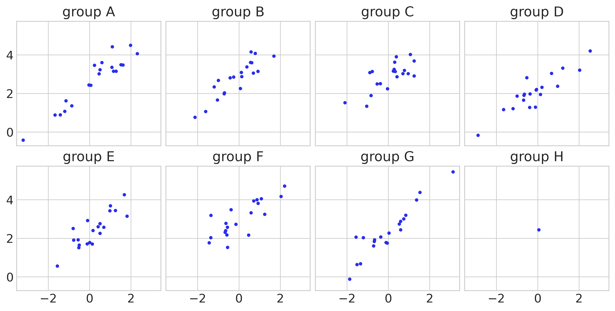
Regression on different groups
One group has much less data

Slide 58
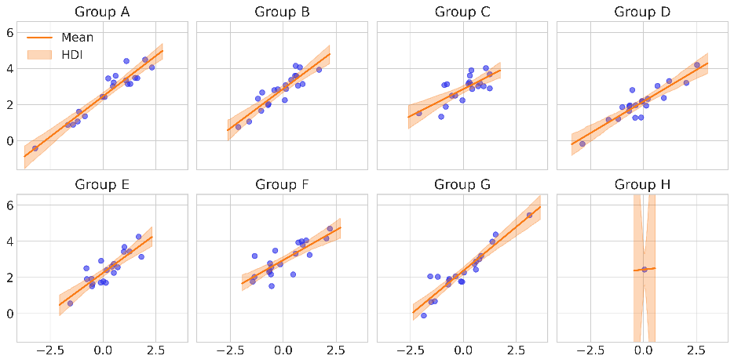
Fitting an unpooled model
Like fitting 8 different regressions

Slide 59
A hierarchical regression model
with pm.Model(coords=coords) as hierarchical_centered:
# hyper-priors
α_μ = pm.Normal("α_μ", mu=μ_αμ, sigma=σ_αμ)
α_σ = pm.HalfNormal("α_σ", σ_ασ)
β_μ = pm.Normal("β_μ", mu=0, sigma=β_αμ)
β_σ = pm.HalfNormal("β_σ", sigma=β_ασ)
# priors
α = pm.Normal("α", mu=α_μ, sigma=α_σ, dims="group")
β = pm.Normal("β", mu=β_μ, sigma=β_σ, dims="group")
σ = pm.HalfNormal("σ", σ_σ)
_ = pm.Normal("y_pred", mu=α[idx] + β[idx] * x_m, sigma=σ, observed=y_m, dims="data")

Slide 60
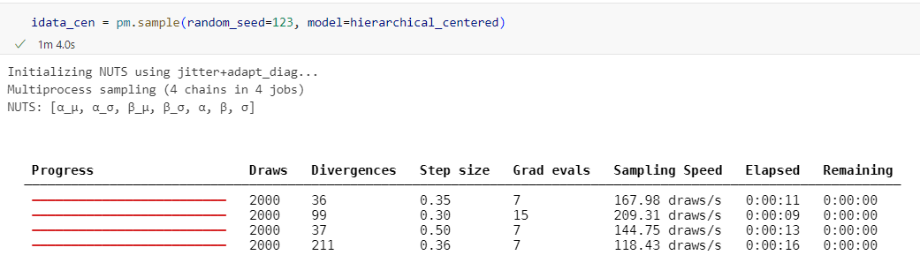

Problems with the model

Slide 61

The funnel
As sigma gets small, the ‘space’ gets tighter and tighter
The scale of the posterior is not consistent
Tuning of the HMC is hard
β = pm.Normal("β", mu=β_μ, sigma=β_σ,
dims="group")

Slide 62

In the funnel all groups get approach the mean
So the difference between them goes towards 0

Slide 63
How to avoid the funnel
Separate sampling of group offset from offset scaling
Sample scaling from prior (like before)
Sample offsets from a standard normal
Combine deterministically
One parameter is input to distribution of another
β_μ = pm.Normal("β_μ", mu=0, sigma=β_αμ)
β_σ = pm.HalfNormal("β_σ", sigma=β_ασ)
β = pm.Normal("β", mu=β_μ, sigma=β_σ, dims="group")
Parameters are independent
β_μ = pm.Normal("β_μ", mu=0, sigma=β_αμ)
β_σ = pm.HalfNormal("β_σ", sigma=β_ασ)
β_offset = pm.Normal("β_offset", mu=0, sigma=1, dims="group")
β = pm.Deterministic("β", β_μ + β_offset * β_σ, dims="group")

Slide 64
Separating is called non-centered sampling
Centered:
β sampled centered on mean
Non-centered
β offset sampled centered on 0, then shifted and scaled
Centered
β_μ = pm.Normal("β_μ", mu=0, sigma=β_αμ)
β_σ = pm.HalfNormal("β_σ", sigma=β_ασ)
β = pm.Normal("β", mu=β_μ, sigma=β_σ, dims="group")
Non-centered
β_μ = pm.Normal("β_μ", mu=0, sigma=β_αμ)
β_σ = pm.HalfNormal("β_σ", sigma=β_ασ)
β_offset = pm.Normal("β_offset", mu=0, sigma=1, dims="group")
β = pm.Deterministic("β", β_μ + β_offset * β_σ, dims="group")

Slide 65

Non-centered model has better sampling
Centered
Non-centered

Slide 66


Fewer divergences
Also samples deeper into the funnel
Centered
Non-centered

Slide 67

Final posterior

Slide 68


Hierarchical model generalizes
Unpooled
Hierarchical

